Slide 1

Design and Implementation of a Secure, Self-Hosted Generative AI Chatbot Platform
Privacy, Performance, and Autonomy in the Age of Generative AI
Under the Guidance of: Mr. Lakshman (G)
Department: Department of Computer Science and Engineering (Data science)
Team Members:Gugulothu Bhavith (23XY1A6704)
Korra Akhil (23XY1A6705)
Anavena Subhash (24XY5A6701)

Slide 2
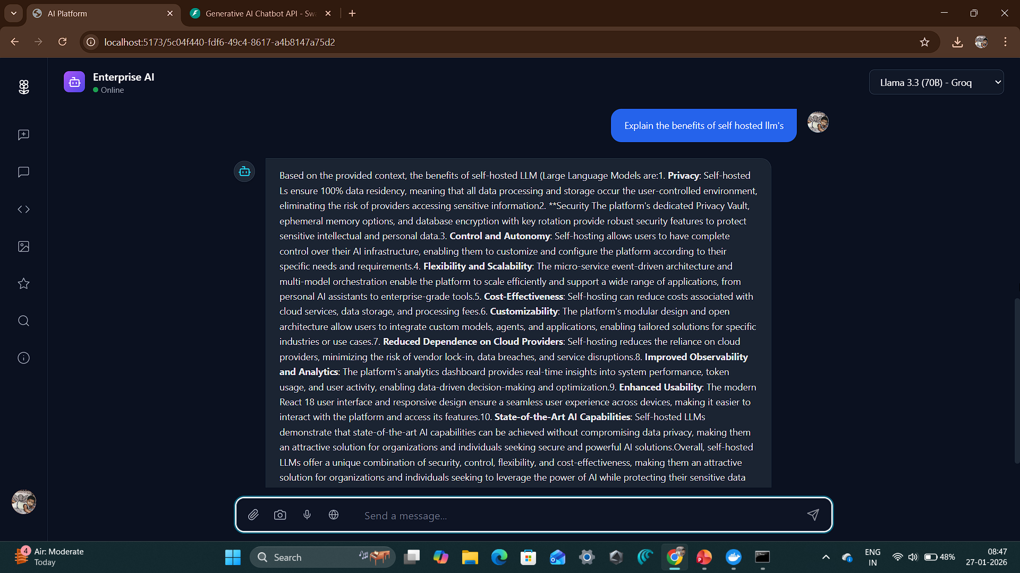

Slide 3
CHALLENGE
The AI Trust Gap
Cloud-based AI systems present significant challenges for organisations handling sensitive data. The reliance on external providers creates vulnerabilities in data governance, performance, and operational autonomy.
Data Governance
Latency
Cloud-based AIs pose serious risks for sensitive academic, research, and enterprise data, compromising institutional control.
API round-trips can be slow for real-time applications, impacting user experience and productivity.
Dependency
Compliance Challenges
Reliance on third-party vendors and fluctuating API pricing creates operational and financial uncertainty.
Meeting data protection and privacy regulations becomes complex when data traverses external systems.

Slide 4
SOLUTION
Secure Sovereign AI Platform
Our platform addresses these challenges through a fully self-hosted architecture that prioritises data sovereignty, multi-provider flexibility, and advanced autonomous capabilities.
Fully Self-Hosted
Data Sovereignty
Runs entirely on local infrastructure or private cloud (VPC), ensuring complete control over the deployment environment and data flow.
User data never leaves institutional or enterprise systems, maintaining absolute privacy and compliance with data protection regulations.
Multi-Provider Agility
Autonomous Agents
Supports Groq, Gemini, OpenRouter, and local Ollama, providing flexibility and avoiding vendor lock-in.
Enables multi-step reasoning and complex task execution beyond basic chatbot functionality.

Slide 5
Technology Stack Overview
Our platform leverages cutting-edge technologies across the full stack to deliver enterprise-grade performance, security, and scalability.
Domain
Technology
Frontend
React 18, Vite, TypeScript, Tailwind CSS
Backend
FastAPI (Python 3.11), Uvicorn
Database
PostgreSQL (Relational), ChromaDB (Vector)
Caching
Redis (Session History & Performance)
Orchestration
Docker, Docker Compose
AI/ML
Ollama, Groq, Gemini, Faster Whisper, BGE-Large
This modern stack ensures high performance, maintainability, and seamless integration across all system components.

Slide 6

CORE FEATURE
Intelligent Multi-Model Chat
Our chat interface provides seamless access to multiple state-of-the-art language models with ultra-low latency streaming and persistent session management.
300
Key Capabilities
Tokens/Sec
Support for Llama 3.3 (70B), DeepSeek V3, and Gemini 2.0
Streaming speed via Groq
Ultra-low latency streaming at approximately 300 tokens per second via Groq
Persistent session management using Redis and PostgreSQL
Syntax-highlighted code output for technical queries
3
Real-time model switching without losing conversation context
AI Models
Llama, DeepSeek, Gemini

Slide 7
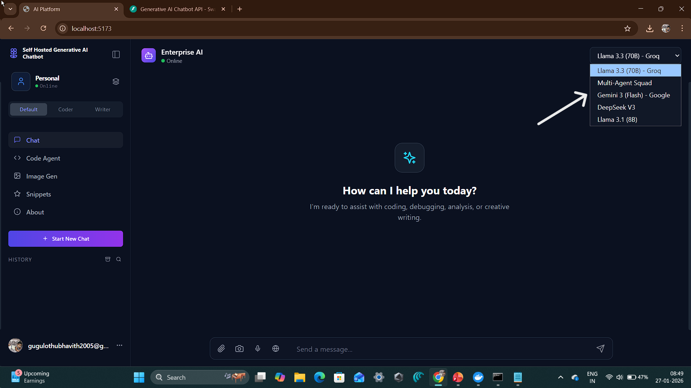

Slide 8
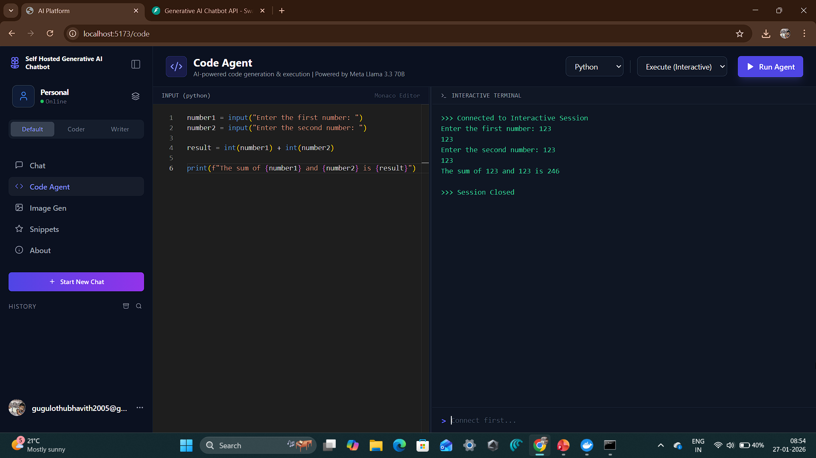

Slide 9





ADVANCED AI
Agent Swarm: Multi-Agent System
Our autonomous agent architecture enables complex, multi-step reasoning through specialised agents working in coordination to solve sophisticated problems.
Planner Agent
Breaks down user queries into structured, actionable tasks with clear execution paths.
Coder Agent
Implements secure Python logic in a sandboxed environment with real-time execution monitoring.
Reviewer Agent
Verifies output accuracy and security compliance before delivering results to users.
Researcher Agent
Performs real-time web searches using DuckDuckGo to augment responses with current information.

Slide 10
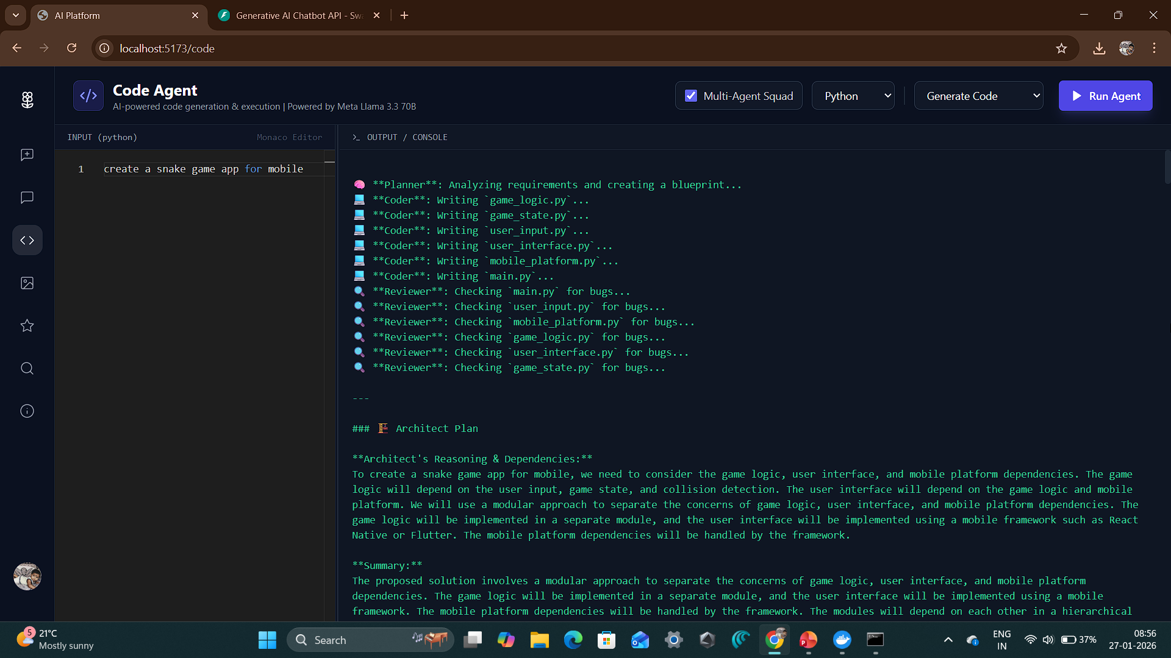

Slide 11

RAG
RAG - Talk to Your Data
Retrieval-Augmented Generation (RAG) enables users to interact with their own documents through natural language, transforming static files into dynamic knowledge sources.
Document Processing
01
Drag-and-drop upload for PDF, DOCX, and TXT files
Upload Documents
Automatic text extraction and chunking
Drag and drop files into the platform
Semantic embedding generation using BGE-Large
Intelligent Retrieval
02
ChromaDB integration for semantic vector search
Vector Embedding
Context injection: automatically appends relevant document sections into AI prompts
Documents are processed and stored in ChromaDB
Source attribution with document references in responses
03
Semantic Search
Relevant context is retrieved based on queries
04
Contextual Response
AI generates answers using document context

Slide 12
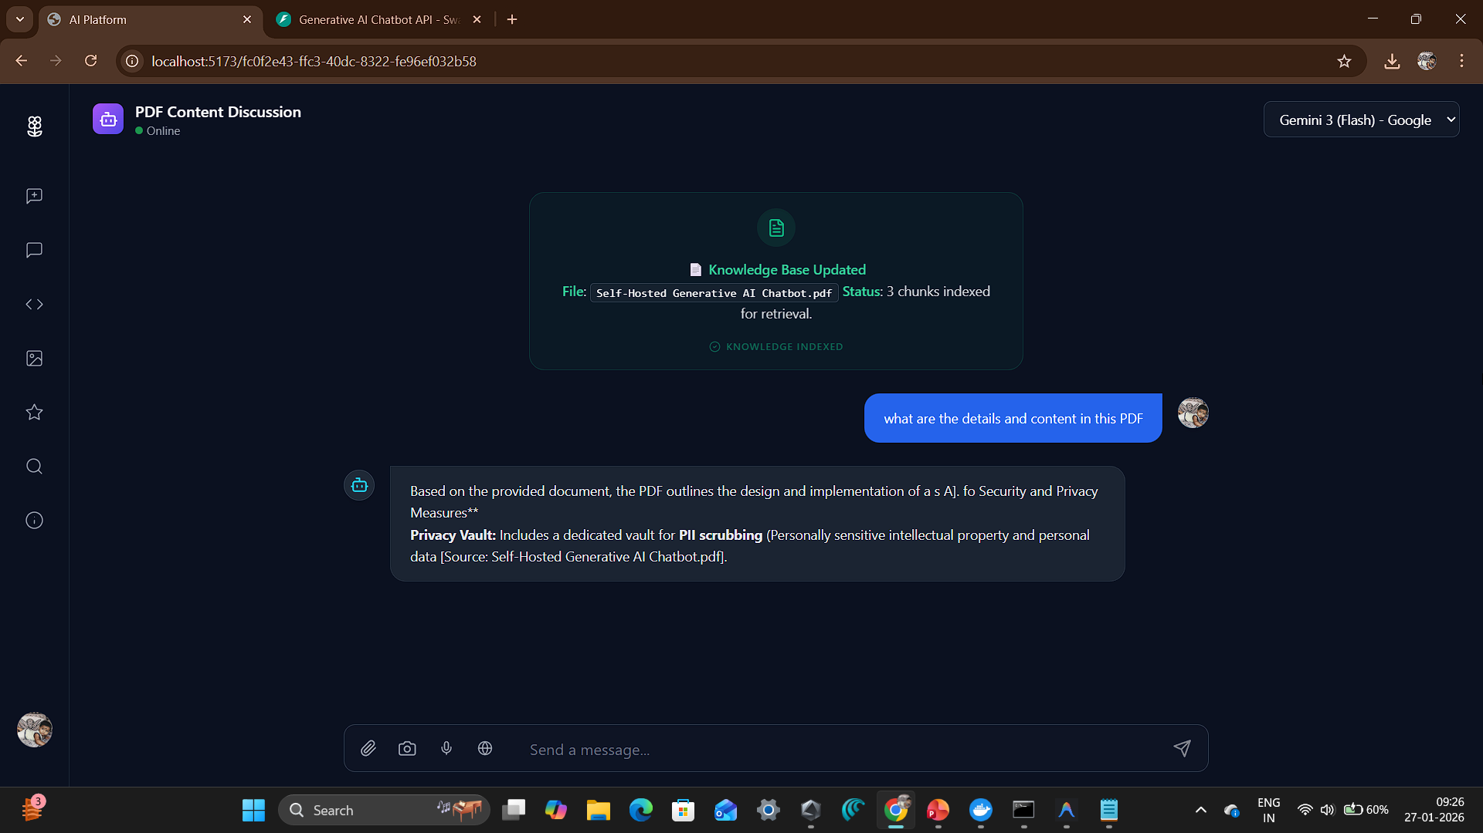

Slide 13


MULTIMODAL
Vision and Voice Capabilities
Our platform extends beyond text to support comprehensive multimodal interactions, enabling users to communicate through images and voice.
Vision Processing
Voice Interaction
Powered by Google Gemini, our vision capabilities enable sophisticated image understanding and analysis.
Seamless speech-to-text and text-to-speech capabilities make the platform accessible and convenient.
Optical Character Recognition (OCR) for text extraction
Speech-to-Text (STT)
Object detection and classification
Powered by Whisper Large V3 via Groq for accurate transcription with support for multiple languages and accents.
Scene understanding and image description
Visual question answering
Text-to-Speech (TTS)
"Upload an image and ask questions about its content, extract text, or analyse visual elements with AI-powered precision."
Unreal Speech with Sierra Voice delivers natural-sounding audio output for AI responses.
Accessibility First: Voice features ensure the platform is usable for all users, including those with visual impairments or mobility challenges.

Slide 14
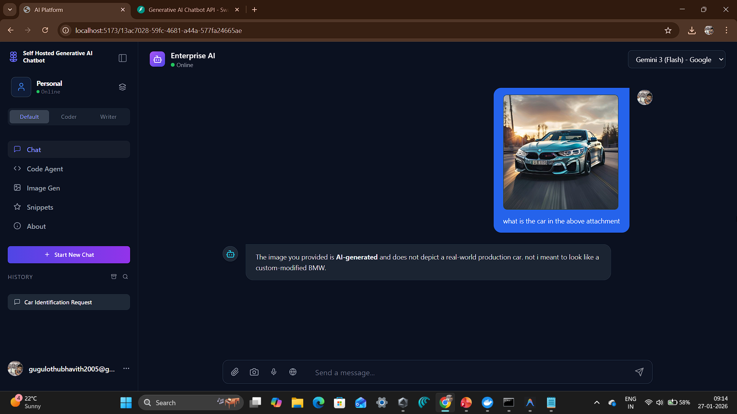

Slide 15





SECURITY
Privacy and Security Vault
Security is embedded at every layer of our architecture, ensuring data protection, user privacy, and system integrity through multiple defence mechanisms.
Secure Sandbox
PII Scrubbing
Code agents run inside isolated Docker containers, preventing unauthorised system access and ensuring execution safety.
Automatic removal of emails, phone numbers, and other personally identifiable information before database storage.
Authentication
Database Hardening
JWT-based login system with secure token management and session handling for user access control.
Encrypted fields, secure access control, and regular security audits protect stored data from unauthorised access.
All security measures are designed to meet enterprise compliance requirements whilst maintaining system performance and usability.

Slide 16
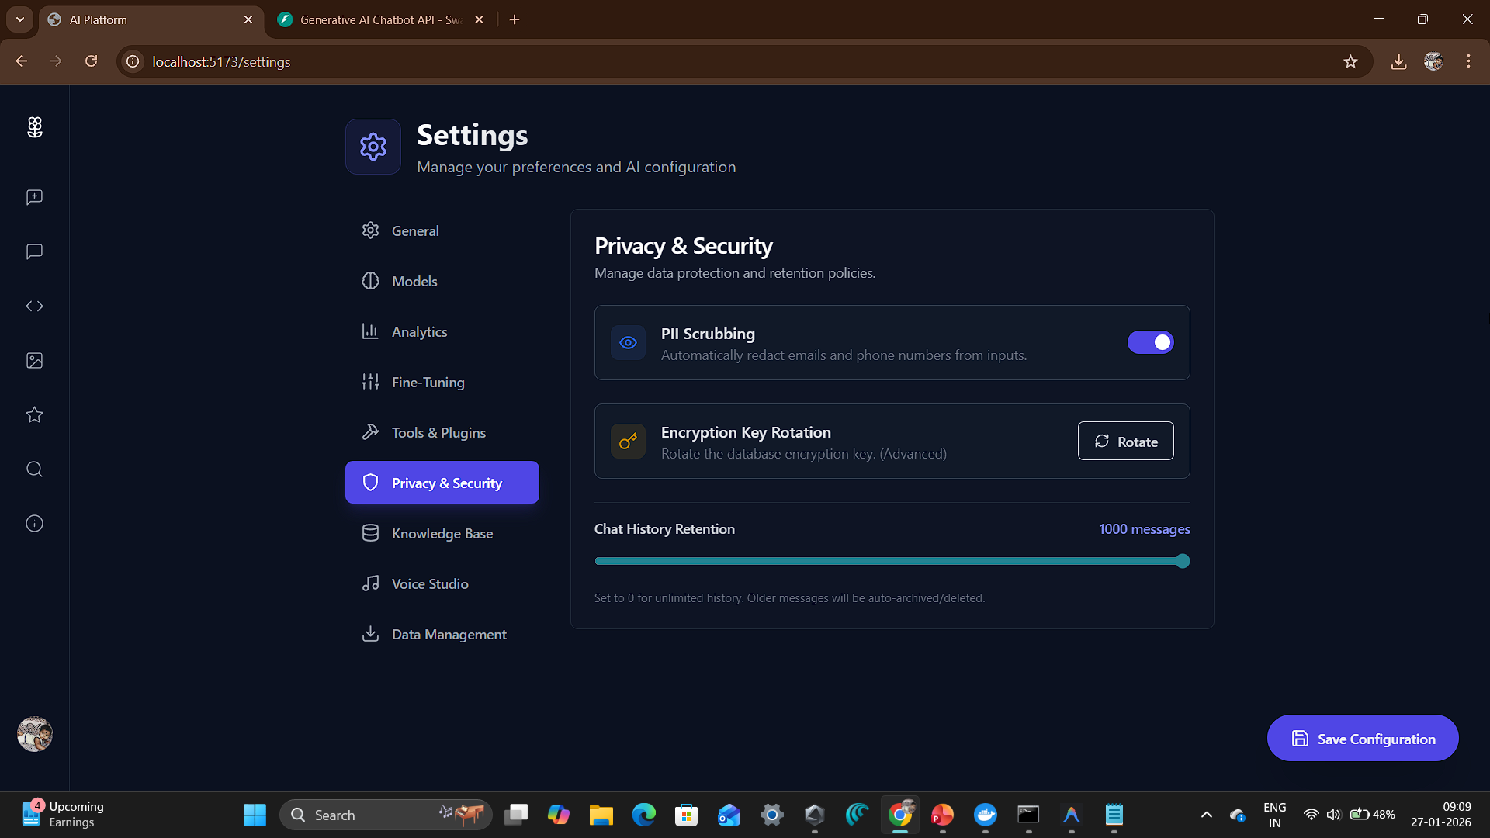

Slide 17
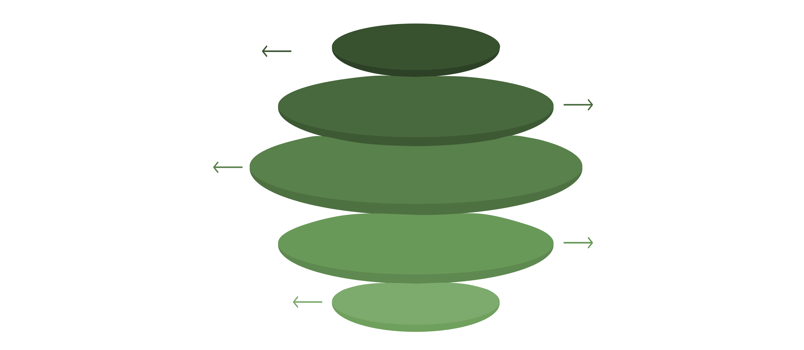
System Architecture
Our architecture follows a modular, microservices-based design that ensures scalability, maintainability, and fault tolerance across all system components.
React UI
Bidirectional REST/WebSocket to gateway
FastAPI Gateway
Central API, routing and auth layer
Data Layer
Redis, PostgreSQL, ChromaDB storage
Agent Orchestration
Planner → Coder → Docker → Reviewer
External & Local AI Models
Groq, Gemini Vision, Ollama local

Slide 18

PERFORMANCE
Performance & Benchmarking
Our platform is engineered for speed, accuracy, and efficiency, consistently delivering superior performance across all critical metrics.
97%+
100+
Reasoning Accuracy
Requests/Sec
High precision through consensus-based validation.
Achieved with caching enabled for high throughput.
<10ms
API Latency
Sub-10ms for internal API processing ensures rapid interactions.
These benchmarks demonstrate our commitment to delivering a high-performing, reliable, and responsive generative AI chatbot experience.

Slide 19

Q&A
Questions & Discussion
We've covered a lot of ground today. Now, we'd love to hear your thoughts, answer any questions you might have, and discuss how this platform can address your specific needs.
Please feel free to connect with us for more detailed information or to explore potential collaborations:
Thank You
We extend our sincere gratitude to our guide, faculty members, and evaluators for their invaluable time, insights, and continuous guidance throughout this project.
We deeply appreciate the opportunity to present our work today.
Design and Implementation of a Secure, Self-Hosted Generative AI Chatbot Platform

